Slide 1


Thermal Imaging Loan Project Training
Suffolk Climate Change Partnership

Slide 2
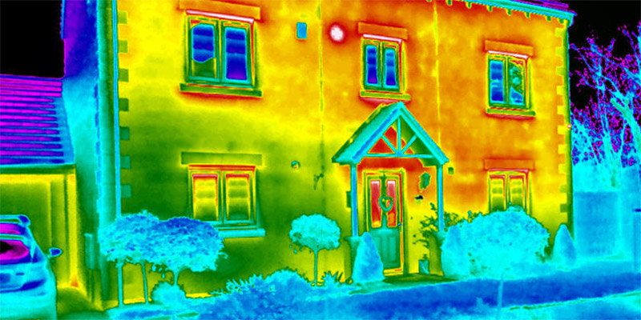
Thermal Imaging
Our aim is to help you raise awareness about insulation in your community so you can help advise people on how to improve the energy efficiency of their home. This could result in:
a reduction in fuel bills
helping people out of fuel poverty
better health and well being
a reduction in carbon emissions
A thermal imaging survey might
identify places which might have draughts
detect whether cavity wall insulation is patchy or missing
detect areas with less loft insulation (though this is harder to do outside)

Slide 3
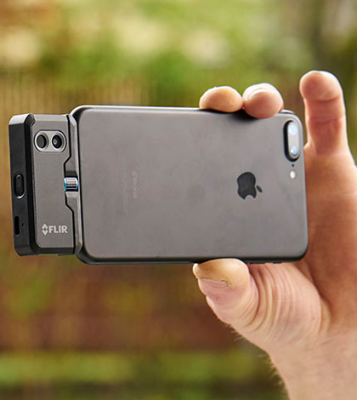
Borrowing a Camera
The person who has signed the agreement form on behalf of your Community Group or Parish/Town Council is responsible for the camera.
Our cameras are insured for loss or accidental damage but please:
  Keep it with you or in a locked place
  Don’t lend it to anyone else
We understand accidents happen so please report any damage or problems ASAP
You will be loaned a Flir One Pro or a Flir One Edge Pro

Slide 4
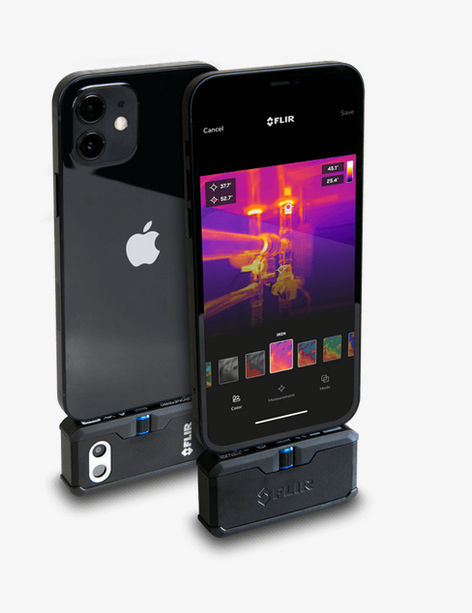
Introducing the Flir One Pro
There are both Android & iPhone versions
Fits into your phone charger point
The camera takes 40 mins to charge & lasts around 1 hour
Your phone battery will also be reduced whilst in use, so we recommended using the portable battery charger with 2 USB points which is supplied too
The camera comes in its own protective case but like your phone they won’t take kindly to drops, bumps or bashes.
Photos can be easily stored on your phone for interpreting in the warmth of your own home. You can then email to them to the householder.

Slide 5
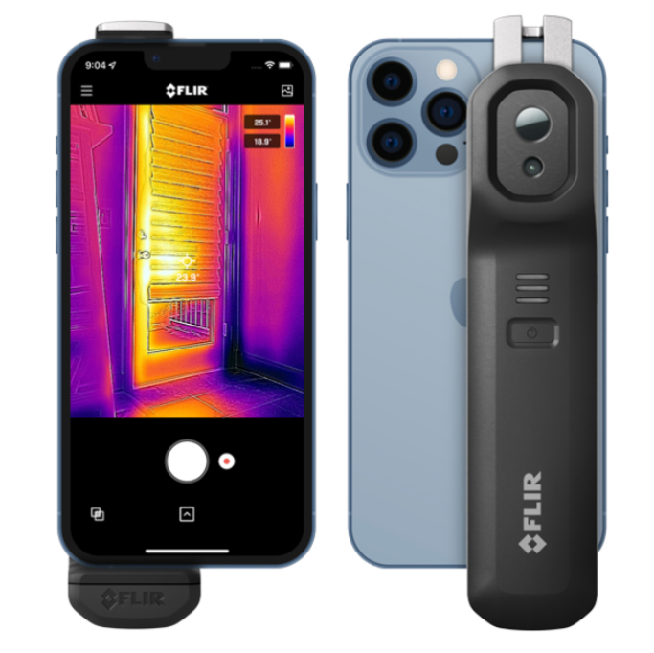
Introducing the Flir One Edge Pro
Bluetooth connection so works with either Android or Apple devices
Can attach to your phone, or be used separately
The battery lasts approximately 2 hours 30 minutes and takes 60 – 90 minutes to charge.
Photos can be easily stored on your phone for interpreting in the warmth of your own home. You can then email to them to the householder.

Slide 6
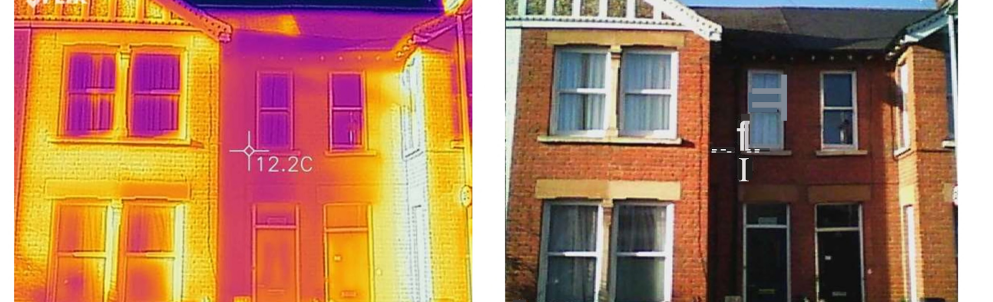
Ideal Conditions for use
Indoors >10°C warmer than out
Enough light for visible images
No direct sun, rain or strong winds
Thermal imaging works best during the colder months
The cameras are available from November to April.

Slide 7
Resources
Please see the website pages for training, householder advice resources and a list of devices which are compatible with each camera:
Thermal Camera Training – Green Suffolk
Thermal Imaging - Next Steps – Green Suffolk

Slide 8
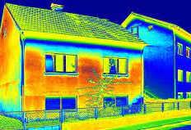
By carrying out community thermal imaging surveys you are not only helping your local community save money and stay warm and healthy this winter, but you are also helping Suffolk reach its target of Net Zero by 2020.
Thermal imaging is a fantastic, straightforward way to diagnose energy leaks from homes.
The images can tell us immediately where costly heat is escaping from such as windows doors, walls and poorly insulated roof

Slide 9
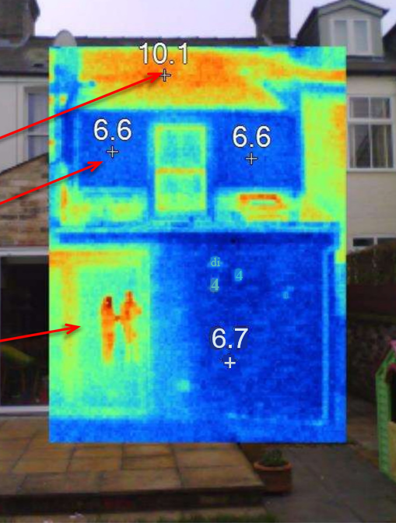
Interpreting the Images
Loft insulation: Poor = Warm
Wall insulation: Good = Cool
People = Reflections in glass (you taking the survey!)
From outside: Warm = Leaky

Slide 10
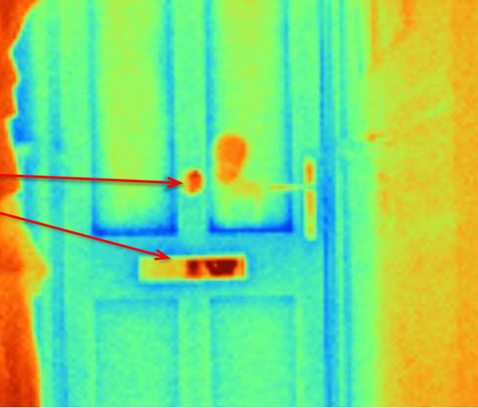
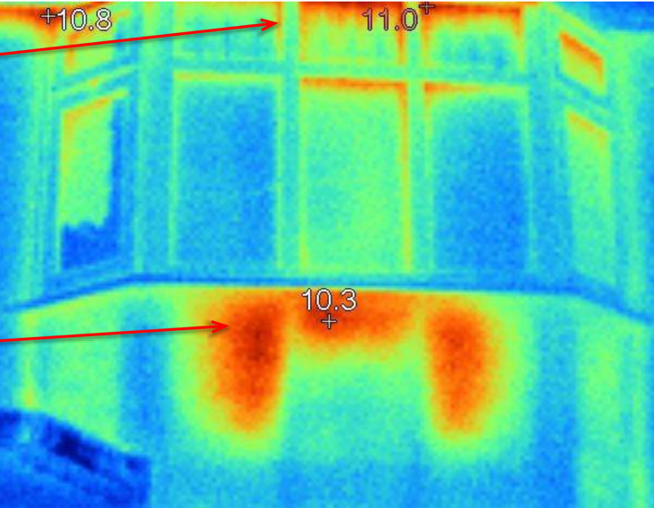
Temperature errors
Shiny metal
Draughty windows
Radiator without a reflective foil panel

Slide 11
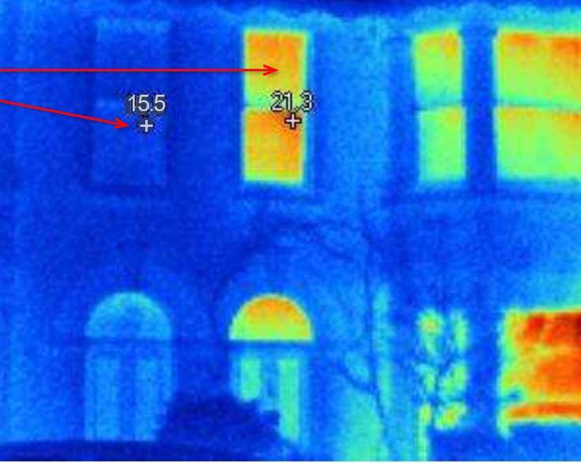
Why are the houses so different?
Different internal temperatures?

Slide 12
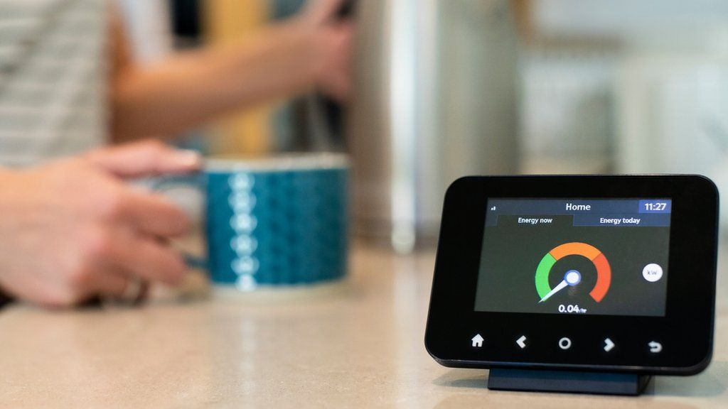
After the Surveys – Then What ?
Share images and survey results with homeowner
Help signpost people in poorly insulated homes (rated D,E,F,G) & income under £36,000 to the Warm Homes scheme
Encourage & support easy DIY insulation & draught fixes
Encourage behavior change (closing curtains, turn down radiators by 1 degree etc)
Fill out the Project Feedback & Evaluation form (emailed at end of loan)
Consider running a Community Bulk Buy project for insulation & draught proofing measures

